Slide 1
Python & SQLITE

Slide 2
Input Dataset
Product
order_id, customer_id, order_date, order_priority, order_quantity, sales, discount, profit, unit_price, shipping_cost product_name
Customer
customer_id, customer_name, province region, customer_segment

Slide 3
Creating Database with sqlite3
sqlite3 is a python module for working with the SQLITE database.
A new database is created with the sqlite3 connection
db_connection_name = sqlite3.connect(“database_name.db")

Slide 4
Creating Table with Cursor
Two tables are created using the cursor that is pointed to the database.
c = db_conn.cursor()
c.execute(“SQL QUERY”)

Slide 5
Reading Data from Excel and Propagating into tables
Data is read into two pandas frames
Data from frames are inserted into table using the to_sql() function of pandas frame
pd_frame_name.to_sql(‘table_name’, db connenction name,…)

Slide 6
SQL Query
SQL queries are run on tables using read_sql() function of pandas.
pd_frame_name.read_sql(“SQL Query”, db connection name)
Also query can be run through cursor’s execute() function
cursor_name.execute(“SQL Query”)

Slide 7
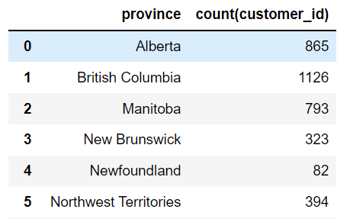
SQL Query Test
Customers’ number according to province (first five):

Slide 8
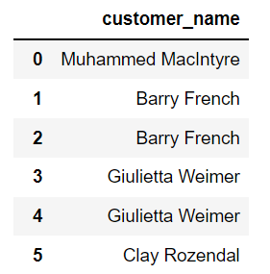
SQL Query Test Continues…
Customers who have not ordered any product (first five):

Slide 9
Thank You

